Slide 1
Universal Design For Learning AND ALLY
Making Accessible Canvas Courses
Parm Gill, Learning Designer
Gabrielle Coombs, Educational Technologist
Notes:
Parm start with slides. And switches to Parm to show UDL section and related web pages. Gabrielle takes over again from slides 12-20

Slide 2
We acknowledge that UBC Vancouver is situated on the traditional, unceded territory of the xwməθkwəy̓əm (Musqueam), Skwxwú7mesh (Squamish), and Səl̓ílwətaʔ/Selilwitulh (Tsleil- Waututh) Nations.
To learn more about First Nations and Indigenous territories where you live, please visit native-land.ca.
Notes:
Speaker Notes:
Parm - LA
Gabrielle – LA
Ask participants to acknowledge where they are situated in the chat if they would like to.

Slide 3
Session Description
Universal Design for Learning (UDL) is a framework that addresses learner differences and helps to improve accessibility for learners. UDL is intended to give all students an equal opportunity to succeed. In this workshop, you will learn about the value of applying the UDL Guidelines and learn about some gaps in the framework. We will also take a look at tools and tips to help improve your courses. Ally is one such tool that can be integrated in Canvas to help you begin. Ally can help make courses more accessible by providing you with a report containing practical guidance with its time-saving interface with identifies and ranks the improvements needed. It also allows students to download documents in alternative formats (like audio or electronic braille). This session will explore Ally in action, and walk you through how to request it for your course.
* Presentation is adapted from an October 2021 designed by Ian Linkletter, Parm Gill and Gabrielle Coombs
Notes:
Speaker Notes:
Orient participants to the Zoom interface. Will will NOT be recording this session because we want participants to feel comfortable asking questions and contributing to the discussion.
It’s important to acknowledge this presentation was originally created by Ian Linkletter, Parm and Gabrielle. It’s been updated and modified since last October.
Mention Zoom reaction functions to communicate during the session. Questions are welcomed and chat will be monitored to address questions as they arise.

Slide 4
Session Outline
PowerPoint Presentation
UDL - CAST Framework (What, Why and How)
Addressing current framework gaps
Accessibility (define), specifically Digital Accessibility part of UDL
Canvas Accessibility Checker and Ally (Benefits and Drawbacks)
Ally Demo
Additional opportunities to enhance accessibility
Questions
Resource links will be posted in the chat as we go and the slide deck will be shared on the ETS website.
Notes:
Speaker Notes
Remind participants that they shouldn't feel pressured to visit the shared links during the presentation if they don't want to. We will be including them in the slide deck materials that will be posted to the ETS site. And if the group is small to use the Zoom hand up feature or chat to ask questions. We’ll keep an eye out for the questions.

Slide 5
Universal design for learning
Notes:
Switch to Parm

Slide 6
UDL
Universal Design for Learning (UDL) is an instructional framework that addresses individual learner differences and needs in order to remove barriers and provide equal opportunities to learn.
The UDL Guidelines (https://udlguidelines.cast.org/) created by CAST are helpful to guide online course design.
Notes:
Speaker Notes
The acronym "CAST" derives from the original name of the organization, Center for Applied Special Technology.
Often accessibility, accommodation and inclusion are addressed AFTER the course has been designed and it is in response to student's needs. This ULD framework is designed to proactively guide the course design process to anticipate and address the variation in learner abilities to access materials, engage with content, instructors and other students as well expressing and communicating their learning. With all the current discussion around whether learning online is working or not, it's important to acknowledge that online/blended learning often has more opportunities to be proactive in removing obstacles for some learners. Especially, when considering the numerous ed tech and multi-media tool options for education.
Action
Share this link in chat:
https://udlguidelines.cast.org/

Slide 7
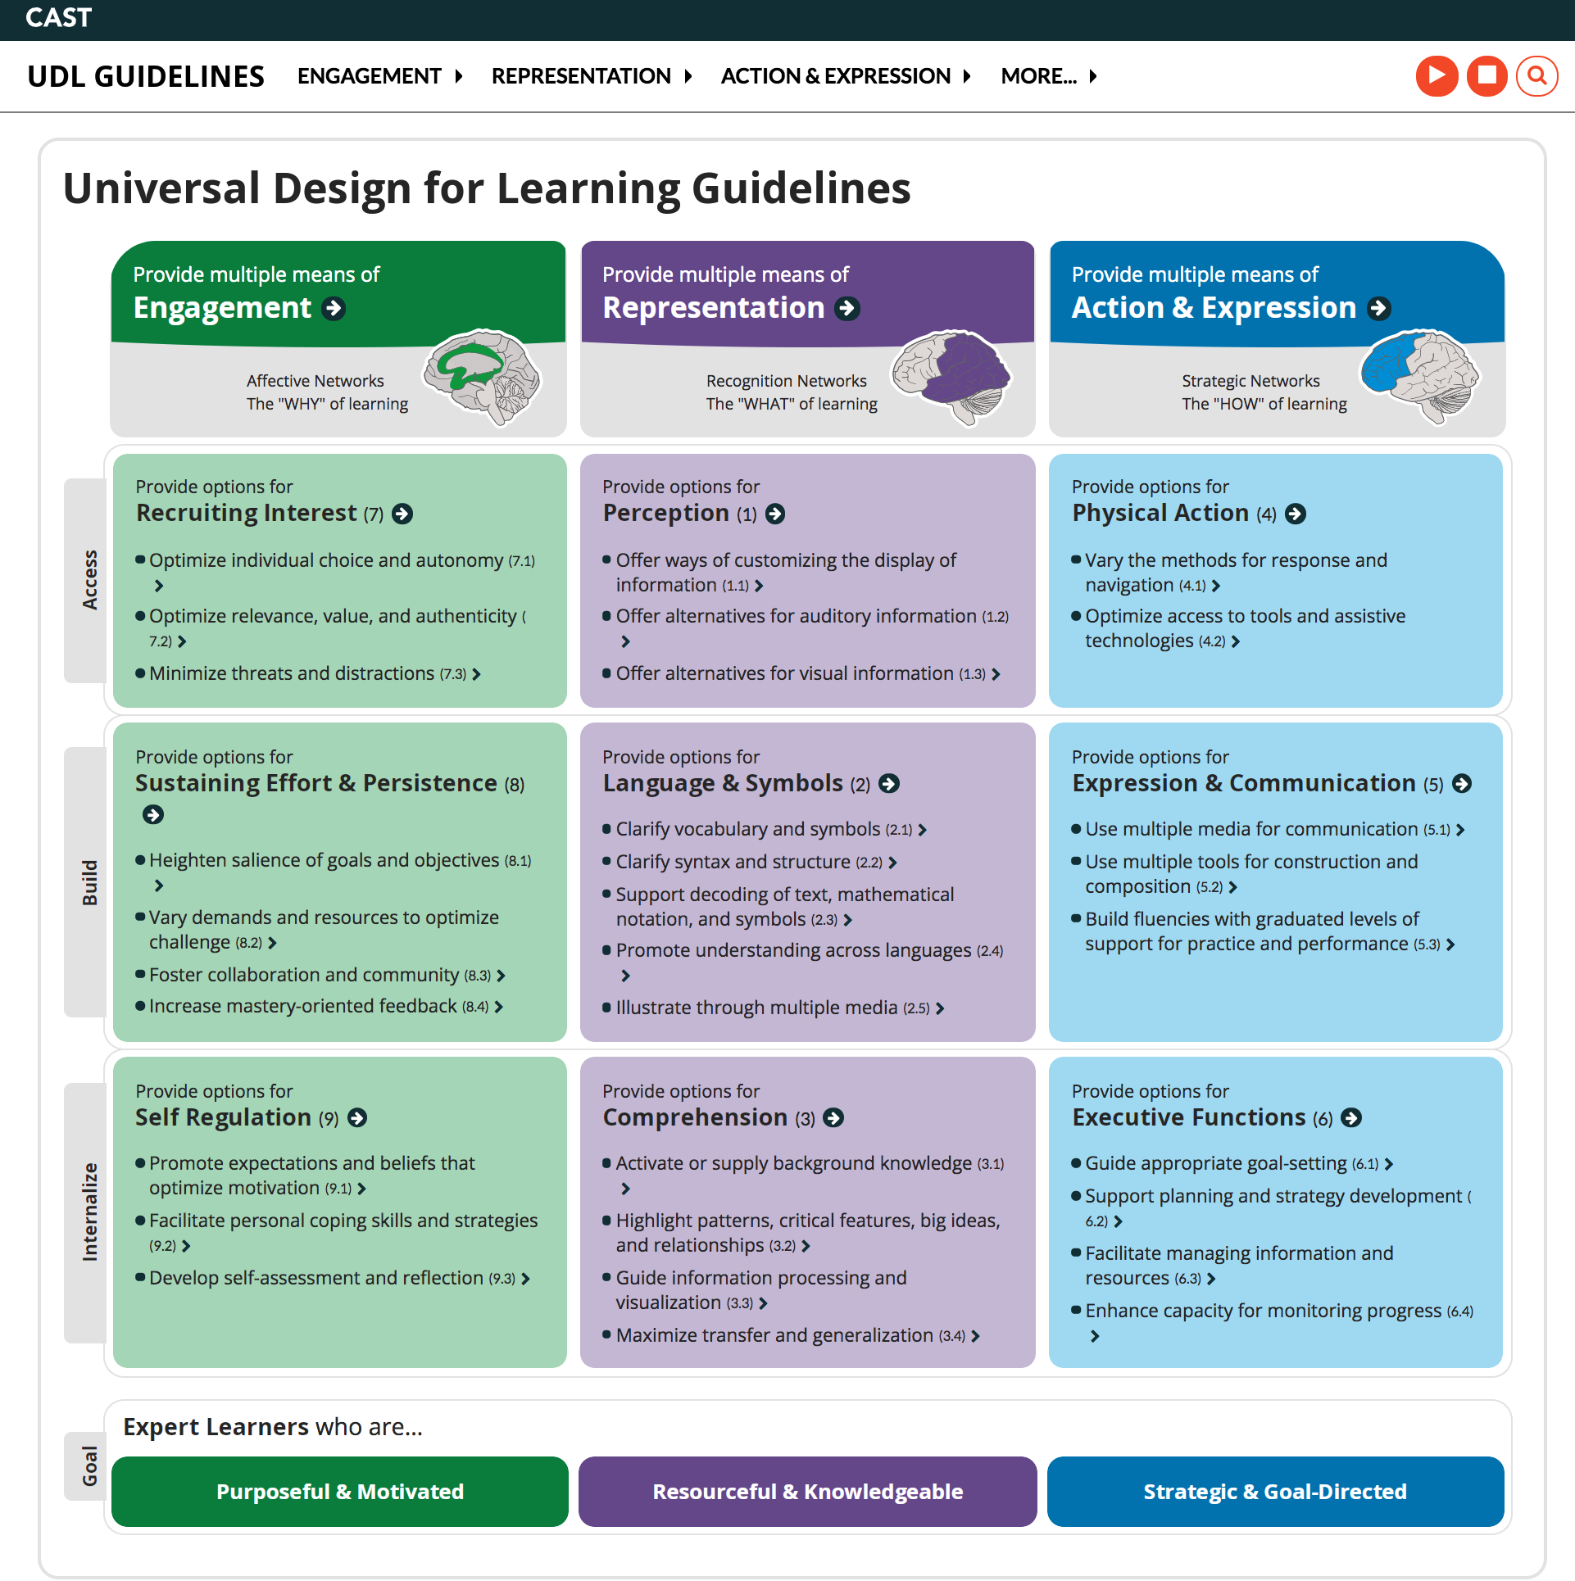
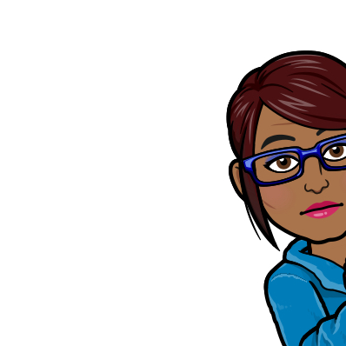
GuIdeLines
These research-based guidelines are organized around 3 principles:
Engagement
Representation
Action and Expression
Visit these links:
https://udlguidelines.cast.org/
https://udlguidelines.cast.org/more/research-evidence
Notes:
Speaker notes
- Engagement principle is based on the affective networks of the brain and addresses the “why” of learning.
- The Representation principle is based on the recognition network of the brain and addresses the “what” of learning.
- The Action & Expression principle is based on the strategic networks of the brain and addresses the “how” of learning.
This chart is a screen shot of the UDL Guidelines (udlguidelines.cast.org) showing the organizing principles and corresponding checklists.
Action
Visit the links to first show the checkpoints and then research to support each checkpoint.
Share these links in the chat:
https://udlguidelines.cast.org/more/research-evidence
https://er.educause.edu/articles/2017/8/a-rising-tide-how-closed-captions-can-benefit-all-students

Slide 8
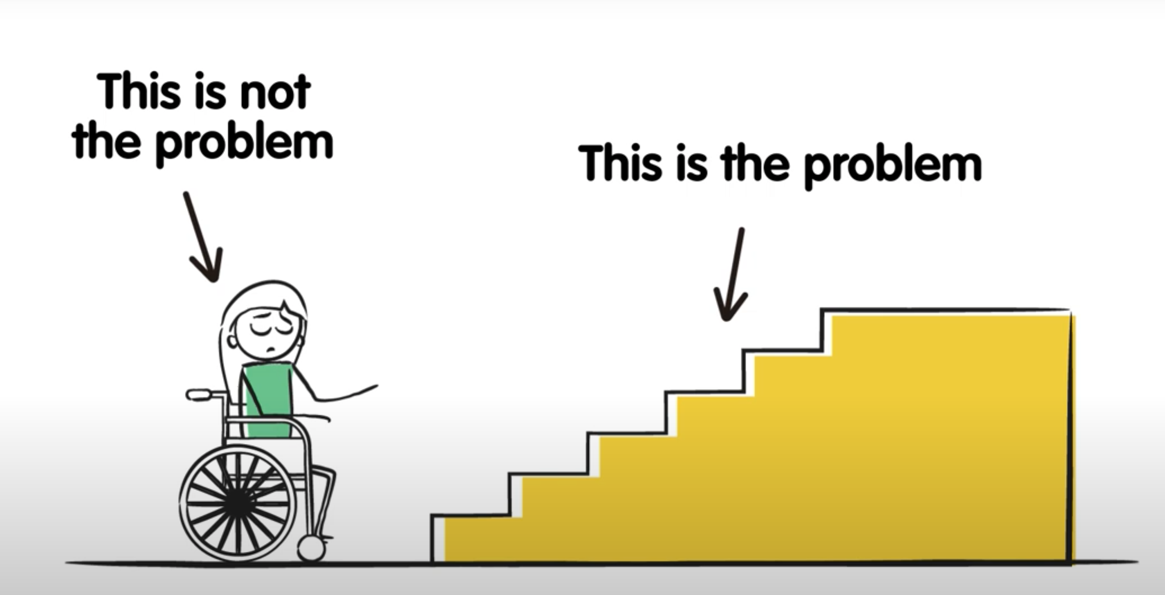
Why UDL Matters?
Traditional education systems were designed for a privileged majority. This left the burden on students to overcome inequitable structures and obstacles that hinder to prevent their learning.
By centering marginalized learner groups in the course design process:
The responsibility shifts back to those with power and ability (institutions, instructors, course designers) to remove obstacles for learners
The UDL approach creates a better learning experience for all learners.
Source: Social Mode of Disablity video from https://pwd.org.au/resources/disability-info/social-model-of-disability/
Notes:
Speaker Notes:
The UDL approach is inline with the social model of disability. This image The graphic is an example of this. It shows how a person in a wheelchair is not the problem, but rather the stairs are the problem. The solution therefore address that (normally a ramp, or an elevator). And often the solution has benefits for many other people. For example people pushing a baby stroller, carrying heavy loads, dealing with other mobility or health challenges, or who simply don't like stairs.
Similarly, the UDL guidelines are designed to help ALL learners, not just students with disabilities. For example, 2017 research on captions showed that the majority of students (up to 90%) found captions useful for learning.
Obstacles are not always as obvious as a wheelchair, and especially when teaching online, obstacles may be harder to recognize. We'll get into that in more detail later.

Slide 9
Gaps
There are gaps in the CAST UDL guidelines from the lens of equity, diversity, and inclusion are being addressed with a goal to promote more inclusive pedagogy in mind.
Good read for a deeper dive:
Cracks in the Foundation: Personal Reflections on the Past and Future of the UDL Guideline (2021)
Notes:
Speaker Notes
The UDL "checklist" approach is intended to address ALL learners, but it as been critiqued as as an oversimplification. And misleading by creating a false sense of meeting all student needs, and therefore can be potentially harmful. For example, there was research report that concluded that the engagement of male and female students doesn’t have equitable outcomes. In this case the female students were more engaged and active in the course, but received the same grade as males. Several years ago I recall there was research that concluded that instructors tend to reply more to students with male names in discussions boards. Basically, there is no clear evidence that using the current UDL framework.
The CAST UDL framework itself is being revamped. There is a community driven initiative, called UDL Rising to Equity initiative to help identify, name, and redress systemic barriers to equitable learning and outcomes.
A better approach is to acknowledge the ever changing and nuances to UDL. Encourage and continue dialogue with your students, and continuously adjust your course based on feedback. Use the framework as a starting point.
Action
Share this link in chat:
https://www.cast.org/binaries/content/assets/common/news/cracks-foundation-whitepaper-20211029-a11y.pdf

Slide 10
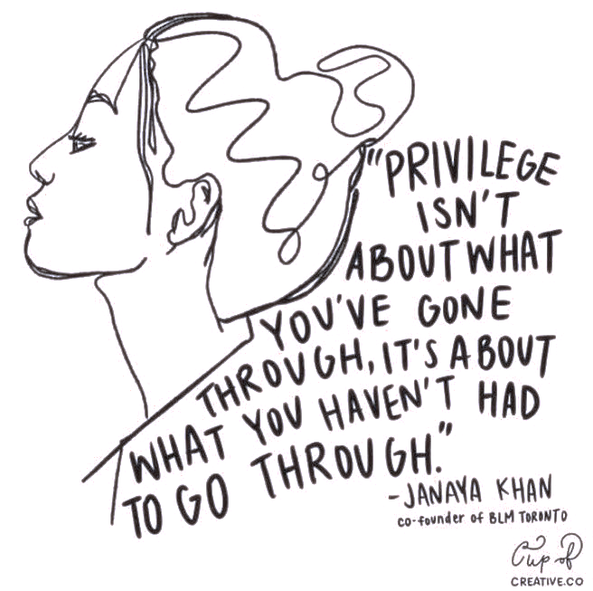
Intersectionality
“If you're standing in the path of multiple forms of exclusion, you're likely to get hit by both.”
— Kimberlé Crenshaw
Notes:
Often when topics of racism or exclusion come up some people respond with “I understand because I grew up poor, or I’m a single mom, or I have a disability…” Those responses, while intended to be understanding end up with the opposite impression.
I like this quote because it doesn't diminish anyone's experience, but it gets us to think about how some factors like race, gender, sexual identity, ability, nationality, etc., can impact what others go through and can compound positive or negative effects.

Slide 11
How to Get Started?
The Backward Design approach works well to apply the UDL guideline. Start with a focus on the learning goals – and what meeting those goals looks like from a student perspective.
Assessments
Learning Activities
Learning Materials
Notes:
Speaker Notes
Assessments – Plan assignments with a range of students in mind. So building in assignment options for students to choose from is something easy to do.
Learning Activities – consider any obstacles that could hinder engagement.
Learning Materials – Using different modes to convey information. Text, audio, images, combinations of both. Removing extraneous information so information is not distracting. Making sure materials are they accessible?
Key take away: Would you rather? approach
Action:
Share link Would you Rather: Designing with Choice in Mind: https://catlintucker.com/2021/02/would-you-rather/

Slide 12
Accessibility

Slide 13
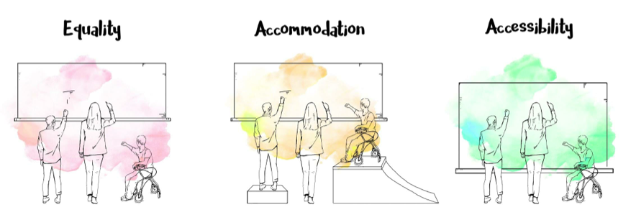
What is Accessibility?
Accessibility is about creating and implementing an even playing ground.
Everyone should be able to equally perceive, understand, interact with and navigate content and situations. There must be an equal opportunity of participation, regardless of how this participation is achieved.
Source: https://flexforward.pressbooks.com/chapter/accessible-education/
Notes:
Speaker Notes:
Designing so the ability for everyone to:
•Acquire the same information
• Engage in the same interactions
• Enjoy the same services

Slide 14
Students
UTS - Students Explain Digital Accessibility
Notes:
Speaker Notes
Introduce the video about digital accessibilty and why it matters to them. Mention the video is under 5 mins.
In many ways online and blended courses offer more opportunites for accessbilty.
Action
Watch the first video on the linked page. Ask participants for feedback? If anything surprised them about the video? Or if there are other aspects of digital accessiblty that may have been missed.
Share link: https://lx.uts.edu.au/blog/2021/04/07/students-explain-digital-accessibility/

Slide 15
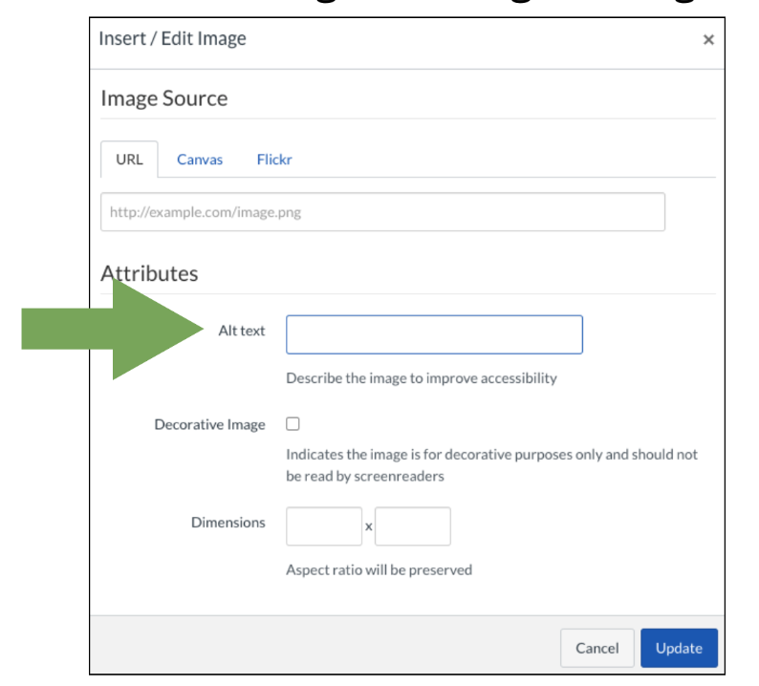
Making Accessible Courses
The text, image, video and interactive content should be accessible for all students.
Accessibility as deliberate practice
Structure your content clearly, and consistently.
Provide captions and/or a transcript for media.
Notes:
Speaker Notes
- For text, things like not underlining text that is not a link, use heading styles for formatting, using heading tags in sequence
- images – alt tag descriptions, consider contract, colour blindness, using text in images (text should be in alt tag because not readable with screed readers)
- video – captions, create videos with multi media principles in mind - - not too busy with audio narration, talking head, text on screen and images.)
Discuss Captions, subtitles, transcripts, alt tags, media – video screen reader friendly ,
Not using, or tagging decorative images as decorative if they are not part of the learning content
Don't use colour to convey meaning.
Action items
Accessible checklist maybe : https://wordpress-futures-prod.s3.ap-southeast-2.amazonaws.com/wp-content/uploads/2020/11/23123847/LX-Accessibility-Practices.pdf

Slide 16
Canvas Accessibility Checker
Benefits
It's already there
Built to align with W3C's Web Accessibility Initiative.
Canvas is clear about accessibility standards on their General Accessibility Design Guidelines page.
Easy to make corrections
Canvas has customizable accessibility settings for users.
Notes:
Action items
Share Canvas guide link: https://community.canvaslms.com/t5/Instructor-Guide/How-do-I-use-the-Accessibility-Checker-in-the-Rich-Content/ta-p/820
Link to UDL course: https://canvas.ubc.ca/courses/31444/pages/1-introduction-to-universal-design-for-learning?module_item_id=1153605

Slide 17
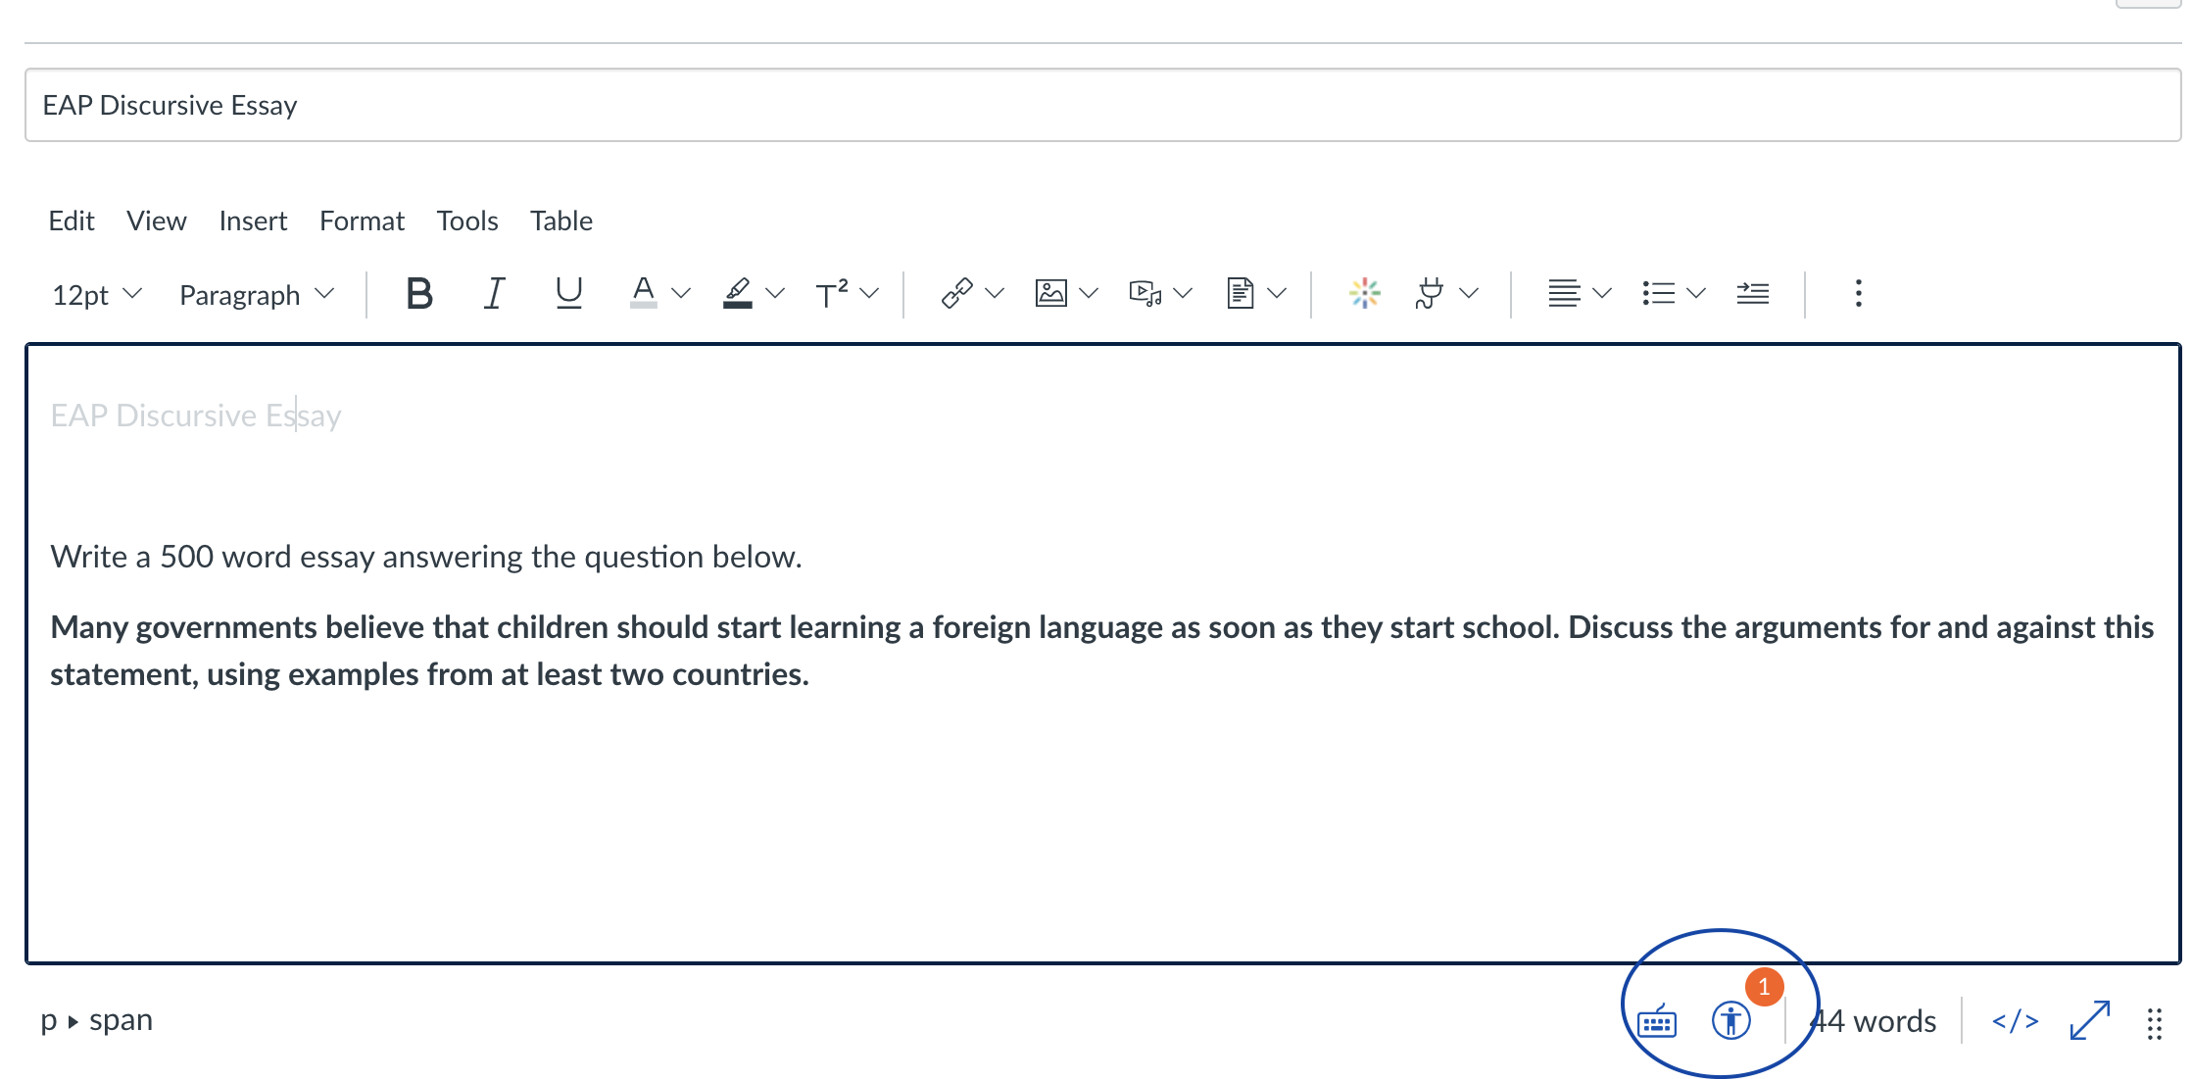
CANVAS ACCESSIBILITY CHECKER

Slide 18
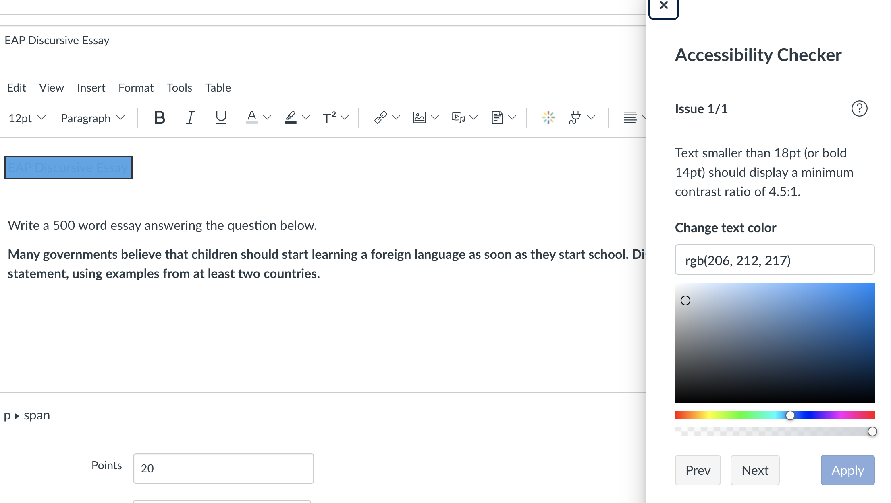
CANVAS ACCESSIBILITY CHECKER

Slide 19
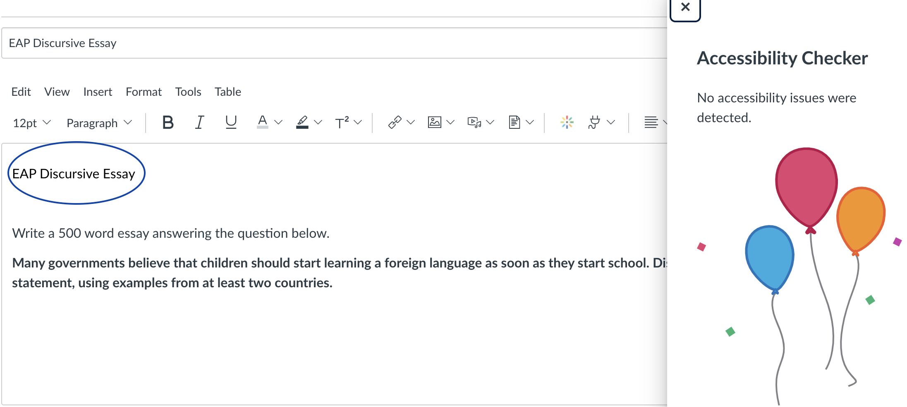
CANVAS ACCESSIBILITY CHECKER

Slide 20
Canvas Accessibility Checker
Cons
Not available everywhere – only in text editors.
No comprehensive report.
Not searchable.
Not as thorough as it could be.
Unrealistic expectations for HTML experience.
Link Checker is in a different location.

Slide 21
Ally & CanVas
Benefits
Provides a report of all issues and the top priorities. It's like a superpower!
Every item is linked and can often be fixed without leaving Ally.
Students are provided with alternative formats for content – for example, downloading text content as an audio file or digital braille.
It's a great way to learn – it doesn't just tell you what to do, but why it is important.
Drawbacks include sensitive settings. Don't beat yourself up if you can't get to 100%.
Another drawback: you will need to ask ETS to turn it on for you.

Slide 22
Interactive – how to write good alt text
Detailed, but succinct
Don't start with "Image of" or "picture of"
Is it decorative?
Consider the purpose and context of the picture – what information should people take away from the image?
Photo by Caleb Martin on Unsplash

Slide 23
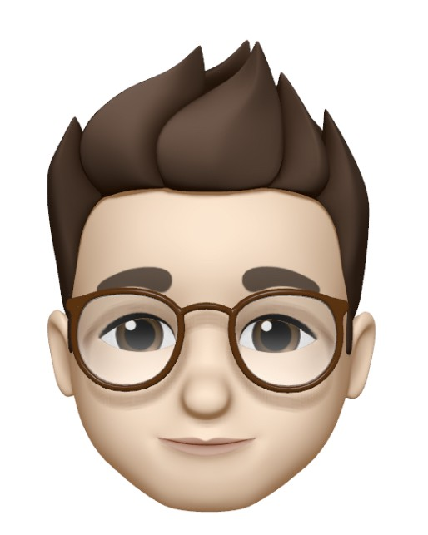
ALLY DEMO

Slide 24
ACCESSIBILITY FOR VIDEOS AND ZOOM
Kaltura Captions (videos)
Zoom Captions (synchronous web conferencing)
Notes:
Kaltura Captions can be requested Zoom captions : https://zoom-captions.elearning.ubc.ca/

Slide 25
Conclusion

Slide 26
What Tech Tools can miss
Quality of alt text
Images with text may not get flagged
Tech can't help with image selection – inclusivity is your responsibility
Tech can't interpret context – is a colour being used to communicate meaning? Is your language respectful? Will your emoji choices be interpreted as you intend?
Internet access may limit access to certain types of media.
Consider trauma aware approaches
Other types of barriers - tech can't solve for equity
Notes:
Speaker Notes
alt tags text should be descriptive (so not using a descriptor like "this is a photo of a person" is not as good "elderly bearded man with glasses reading a book")
be careful of using graphics that convey information as text. Screen readers won't be able to read it. Using charts in content, should have good captions and alt text, and should be near by the text content that describes the chart content.
think about image selection and the messages conveyed. Example –using images of a nuclear family unit normalizes that and exclude other types of family units. Use diverse images that include marginalized groups. Select images/icons/emojies carefully as they can be interpreted differently in different cultures. Example of pray emoji...mention thumb ups emoji
language use and what is convey with that. An example of that is wording for the Global South, was 3rd world nations, then referred to as developing countries. I've also seen alternate terms such as "nations recovering from colonization". All these terms have different connotations. And approaches have changes over the years.
trauma can't be predicated because it can be so personalized – need open communication with students. A text statement in a syllabus often isn't' enough. Recognize that students don't reach out if they haven't had help in the past or feel stigma.
other tech barriers include things like tech embedded biases – Cameras for example were designed for lighter skins and those were categorized as the norm. This is a known issue with facial recognition software. And over covid we realized these embedded racial biases are still an issue with zoom

Slide 27
Resources
Final
Cast - The UDL Guidelines
Educause: A Rising Tide: How Closed Captions Can Benefit All Students
Universal Design Centre - Accessibility and UDL Slides
UK Government Accessibility Blog: Dos and don'ts on designing for accessibility
BC Campus Open Accessibility Toolkit
Students Explain Digital Accessibility
Universal Design for Learning (UDL) for Inclusion, Diversity, Equity, and Accessibility (IDEA)
Kimberlé Crenshaw: What is Intersectionality?
Would you Rather: Designing with Choice in Mind

Slide 28
Notes:
Survey link:

