Slide 1
Copyright for Teaching and Sharing
Content in this slide deck is made available under a CC-BY license unless stated otherwise.
Notes:
This slide deck was created by Stephanie Savage
Image Credit:
“Painter when painting a portrait of a lute player” Marguerite Gerard, Wikipedia, Public Domain

Slide 2
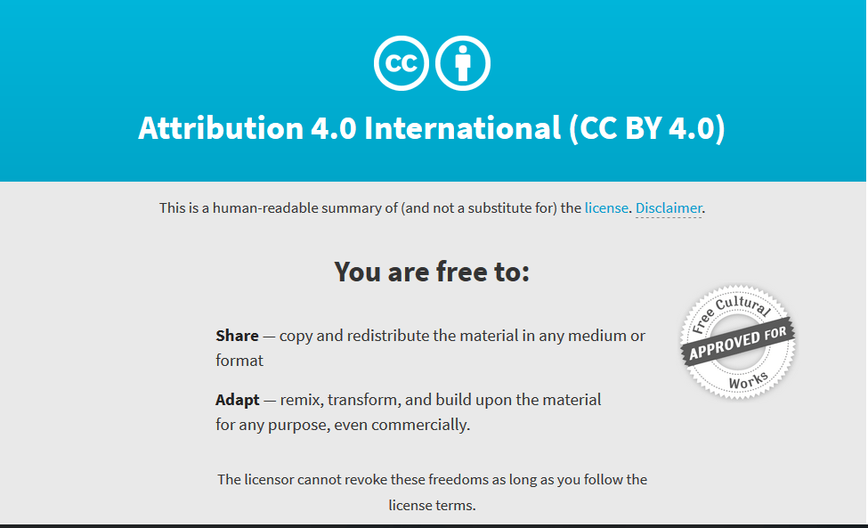
All original content in this presentation is licensed under a CC-BY license, for borrowed works, please refer to attribution statements
CC-BY, Creative Commons, CC-BY

Slide 3
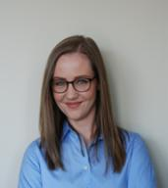
Contact Me
Stephanie Savage
Scholarly Communications and Copyright Services Librarian
604-827-1790
stephanie.savage@ubc.ca
Copyright
Copyright.ubc.ca
Fair Dealing Analysis
Course Materials Review
General Copyright Support and Referral
Scholarly Communications
Scholcomm.ubc.ca
Open Access Publishing
Author Rights
Predatory Publishing
Open Scholarship

Slide 4
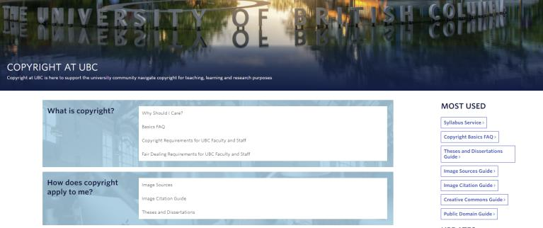
Copyright.ubc.ca

Slide 5
What are you hoping to get out of this session?
Notes:
Photo by Camylla Battani on Unsplash

Slide 6
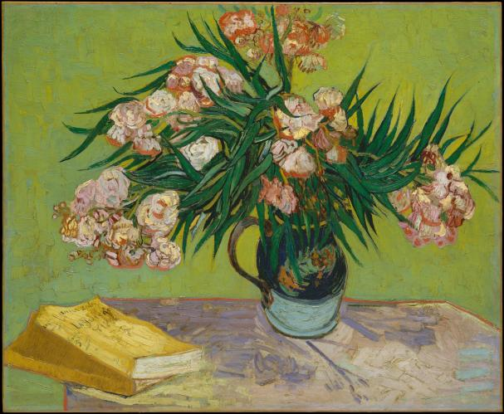
Users
Basics for using copyright-protected materials
Vincent van Gogh, 1888 - Public Domain, Retrieved From the Metropolitan Museum of Art
Notes:
Distinction between users and creators
Will focus on you as users of copyrighted works, but will also spend a little time talking about you as creators of works as well
Note the borrowed images - most are from repositories of freely reusable images including the MET, NASa, Wikimedia commons, the National Library of Medicine etc.

Slide 7
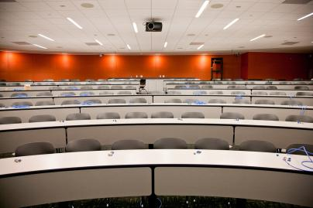
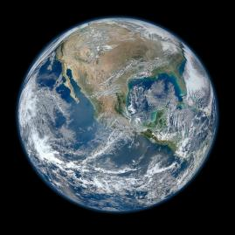
Identifying the Audience
Classroom Use?
Open Distribution?
EdTech Stanford University School of Medicine- CC-BY-NC-ND, Retrieved from FLICKR
Nasa, Public Domain, Retrieved from Nasa Image and Video Library
Notes:
Why is audience important when considering using copyright-protected works?
A first consideration is the audience for the content
If you want to use the content in a UBC course you can take advantage of certain copyright exceptions
If the goal is to make content available to a broader audience there is a more restrictive regime you must follow

Slide 8
Exceptions to Copyright
Fair Dealing | Educational Exceptions
Must be for an allowable purpose | An additional set of exceptions for educational institutions
Is less likely to be applicable in an open environment | Are less likely to be applicable in an open environment
Notes:
Fair Dealing
Must be for an allowable purpose
Are less likely to be applicable in an open environment
Educational Exceptions
An additional set of exceptions for educational institutions
Are less likely to be applicable in an open environmen

Slide 9
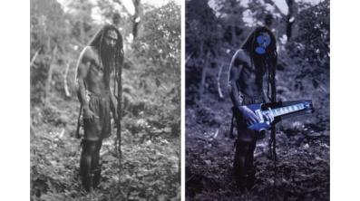
Fair Dealing
Fair dealing permits the use of copyright protected works without asking for permission for one of the following purposes:
Research
Education
Private Study
Criticism
Parody
Satire
Review
News Reporting
Retrieved from: http://illicitculturalproperty.com/note-on-cariou-v-prince/ - used for an educational purpose
Notes:
While Copyright is meant to protect creators and their works, it also seeks to balance creator rights with user rights.
Fair dealing is the heart of what are known as “user rights” in copyright. It is formally known as an exception to copyright. In the US the concept is known as fair use. Fair Dealing means that, in spite of such a use being illegal in other circumstances, the use is legal when it meets the requirements of fair dealing.
To employ a fair dealing to a copying activity you must find a purpose for that copying that corresponds to one of the purposes set out in the law. These are:
Research
Private Study
Education
Parody
Satire

Slide 10
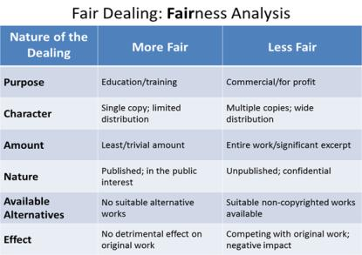
Fair Dealing
In addition to being for an allowable purpose, the dealing must meet the test of “fairness”
Alberta Health Resources - used for an educational purpose
Notes:
CCH v. Law Society of Upper Canada

Slide 11
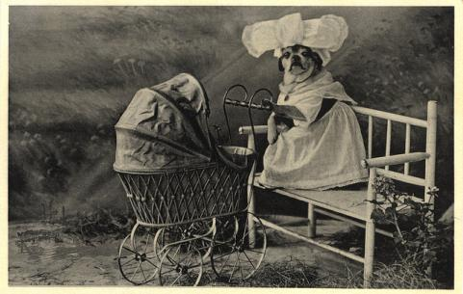
Educational Exceptions
Copyright permits educators to use content for instruction purposes that would otherwise be infringing:
Performing a work (broadcasts, news, sound and video recordings) in the classroom, in-person and via telecommunication
Taking content from the Internet.
Educational exceptions typically don’t apply to OER because it is open to audiences beyond the university campus
Retrieved from the National Library of Medicine - Public Domain
Notes:
educational institution means
(a) a non-profit institution licensed or recognized by or under an Act of Parliament or the legislature of a province to provide pre-school, elementary, secondary or post-secondary education,
(b) a non-profit institution that is directed or controlled by a board of education regulated by or under an Act of the legislature of a province and that provides continuing, professional or vocational education or training,
(c) a department or agency of any order of government, or any non-profit body, that controls or supervises education or training referred to in paragraph (a) or (b), or
(d) any other non-profit institution prescribed by regulation; (établissement d’enseignement)

Slide 12
Copyright is hard!
Hyperlinking and embedding is OK
Using UBC licensed material (in the classroom) is OK
Using openly licensed work is OK
Using anything in the public domain is OK
LaurMG, CC-BY-SA, Retrieved from Wikimedia Commons

Slide 13
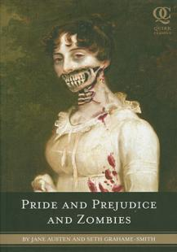
Public Domain
Retrieved From Wikipedia - used for an educational purpose
Retrieved from Spy Museum - used for an educational purpose

Slide 14
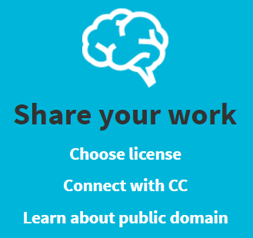
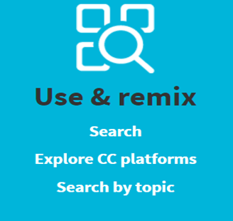
Creative Commons
Notes:
Covered by Will

Slide 15
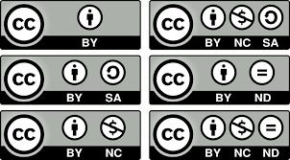
Creative Commons

Slide 16
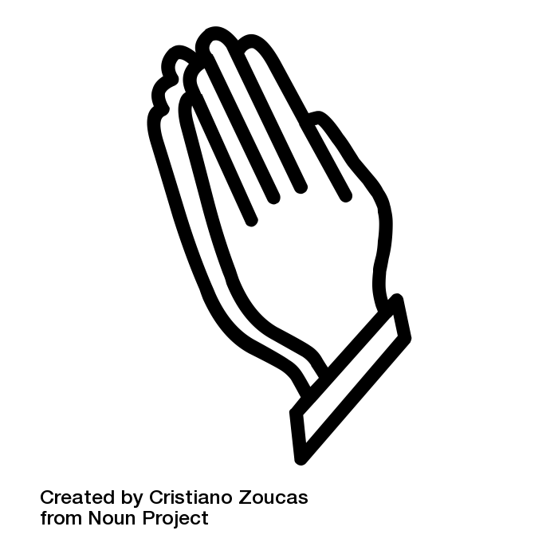
Asking Permission
When in doubt, consider asking for permission
Notes:
Where restrictions are found in Terms of Use, Digital Locks, licences or other 3rd party sources you must obtain permission to use the content
Three steps:
Identify the rights holder
Contact the rights holder
Obtain written permission from the rights holder
Remember: faculty & student academic work at UBC enjoys copyright

Slide 17
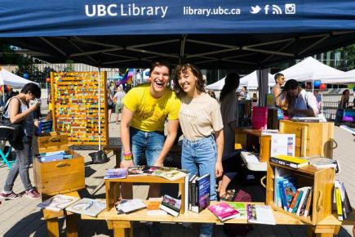
Use the Syllabus Service
The Library is here to help
We will take on the copyright assessment and pay reasonable licensing costs to make works available
UBC Library Communications - CC-BY-NC-ND, Retrieved From Flickr
Notes:
syllabus.service@ubc.ca

Slide 18
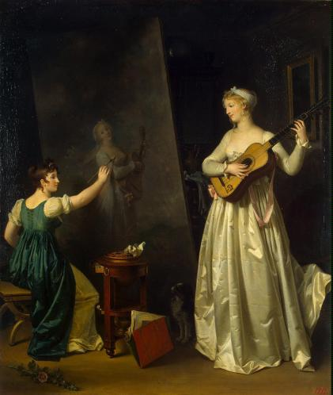
Creators
Basics for creators of copyright-protected materials
Marguerite Gerard, circa 1790 - Public Domain, Retrieved From Wikimedia Commons

Slide 19
Congratulations!
You are the proud owner of many many many copyrighted works!
Copyright is assigned to work as soon as it has been fixed in a tangible medium
Only works that meet the threshold of originality attract protection

Slide 20
Who owns the Rights?
Faculty Work | Student Work | Staff Work
Retain copyright in their work Policy 88 (Inventions and Discoveries) Policy 81 (Use of Teaching Materials in UBC Credit Courses) | Retain copyright in their student work Theses and dissertations are required to be openly disseminated Student employees likely do not retain copyright | Operate under the “work for hire” provision Do not retain copyright in their work

Slide 21
Using Student Work
When in doubt, consider asking for permission

Slide 22
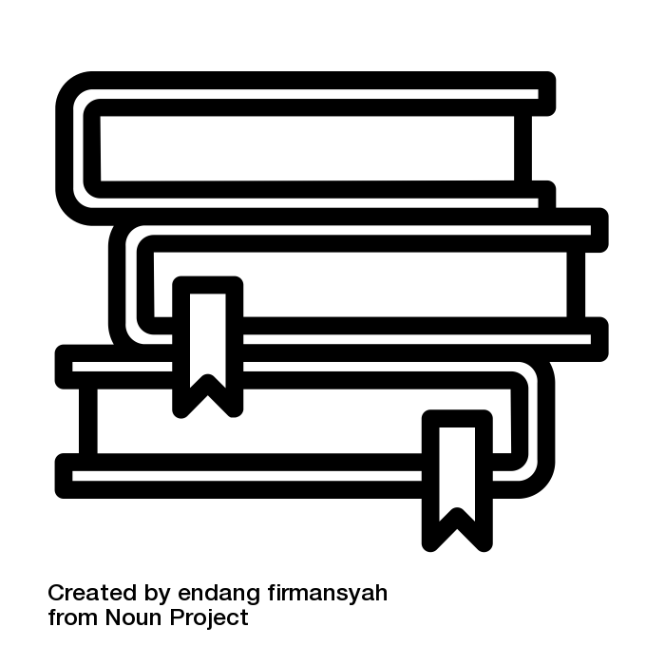
Author Rights
Consider the rights you have in your own work and to what degree you give them up when you publish
Commonly, publication agreements include copyright transfers

Slide 23
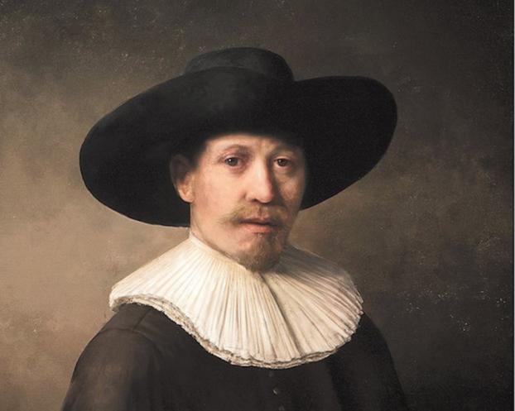
Where Policy ends and Risk begins
The Next Rembrandt, used for an educational purpose, Retrieved from https://www.nextrembrandt.com/

Slide 24
Questions?
Notes:
Image Credit
Photo by Robert Wiedemann on Unsplash

